Slide 1







Capstone project report
LEELA KRISHNA PENDYALA
07/07/2022

Slide 2



OUTLINE
Executive Summary
Introduction
Methodology
Results
Visualization – Charts
Dashboard
Discussion
Findings & Implications
Conclusion
Appendix

Slide 3

EXECUTIVE SUMMARY
Current Technology Usages Trends
Languages
Database
Platform
Web Frame
Future Technology Trends
Language
Database
Platform
Web Frame
Demographics

Slide 4

INTRODUCTION
Purpose of Analysis
To identify the top programming languages, database, platforms and web frames used or in demand.
Audience
Tech users
Computer sciences students
Programmers

Slide 5

METHODOLOGY
Data Sources
Stack overflow developer survery
Programming languages annual salary
Data Wrangling
Data Exploration
Data Cleaning
Python
IBM Cognos

Slide 6
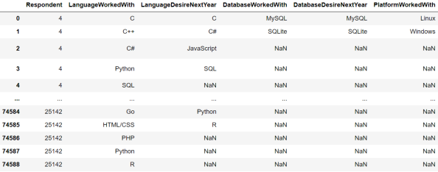
RESULTS

Slide 7
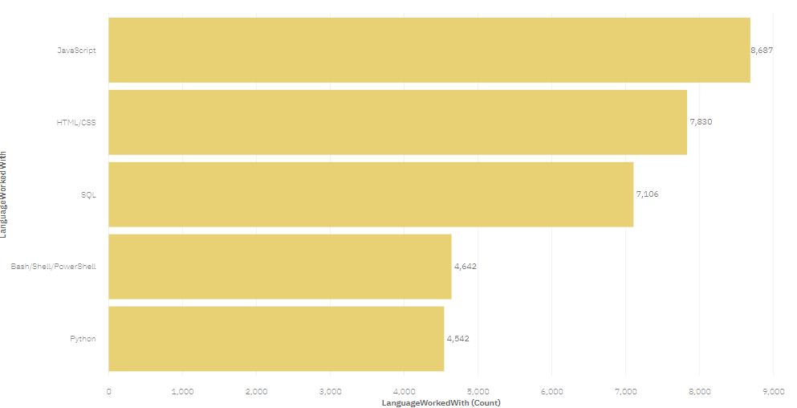
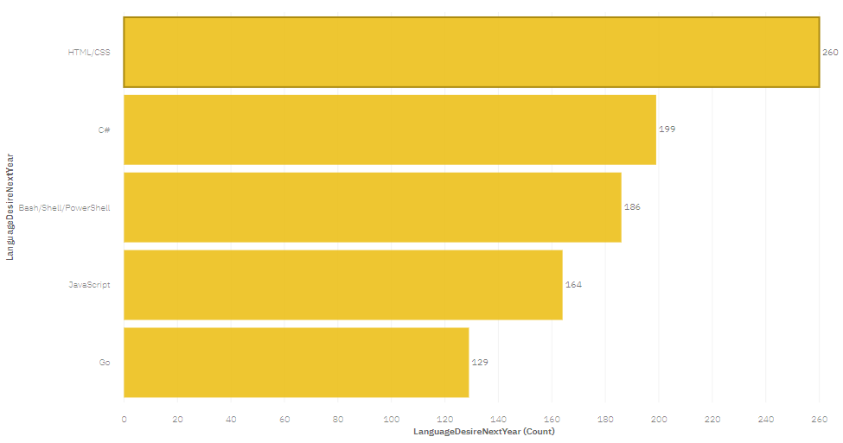
PROGRAMMING LANGUAGE TRENDS
Current Year
Next Year
<Bar chart of top 5 programming languages for the current year goes here.>
< Bar chart of top 5 programming languages for the next year goes here.>

Slide 8
PROGRAMMING LANGUAGE TRENDS - FINDINGS & IMPLICATIONS
Findings
JavaScript is the top language
Python and TypeScript are growing in popularity
HTML and SQL hold large portions of the used languages
Implications
Programming skillsets are in high demand
JavaScript is a must learn for developers
Python is quickly growing as one of the most popular languages

Slide 9
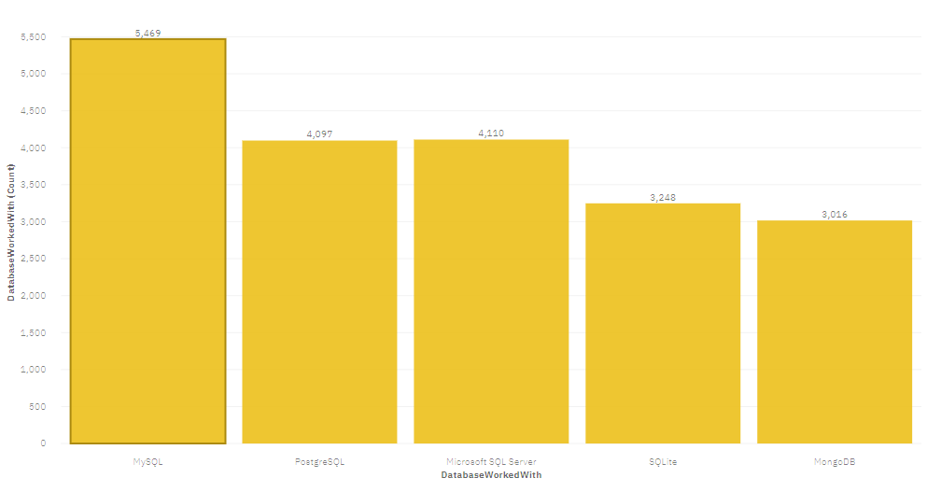
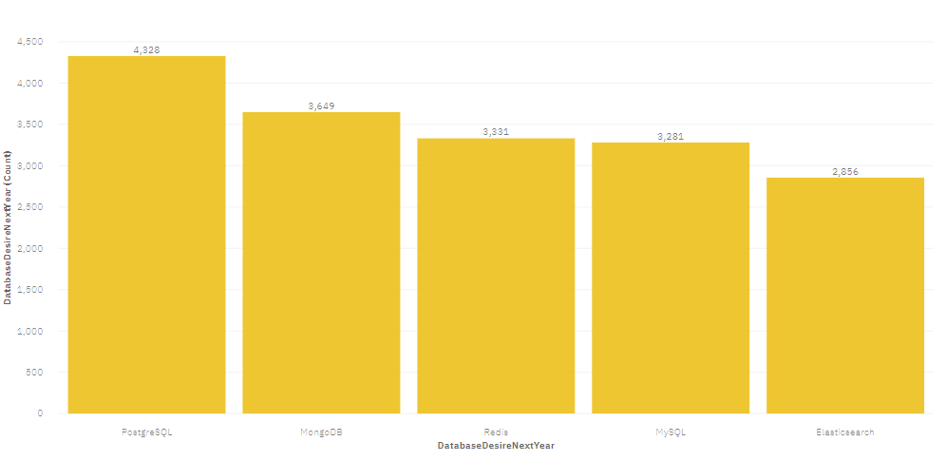
DATABASE TRENDS
Current Year
Next Year

Slide 10
DATABASE TRENDS - FINDINGS & IMPLICATIONS
Findings
MySQL is the most popular database
A lot of current companies use Microsoft SQL Server
NoSQL databases tend to use MongoDB or Redis
Implications
User Prefer Open-source DB solutions
Many companies require SQL
NoSQL databases will make an impact for relational databases

Slide 11

DASHBOARD
https://dataplatform.cloud.ibm.com/dashboards/fb723daa-9c23-471b-9610-c4de0af8e24f/view/6c3cc97e61ea239048afc8e4079b79037a33235ababbd65285d67b4959697397a93d1691c87c4c5e8815566aa2ef170dcd

Slide 12
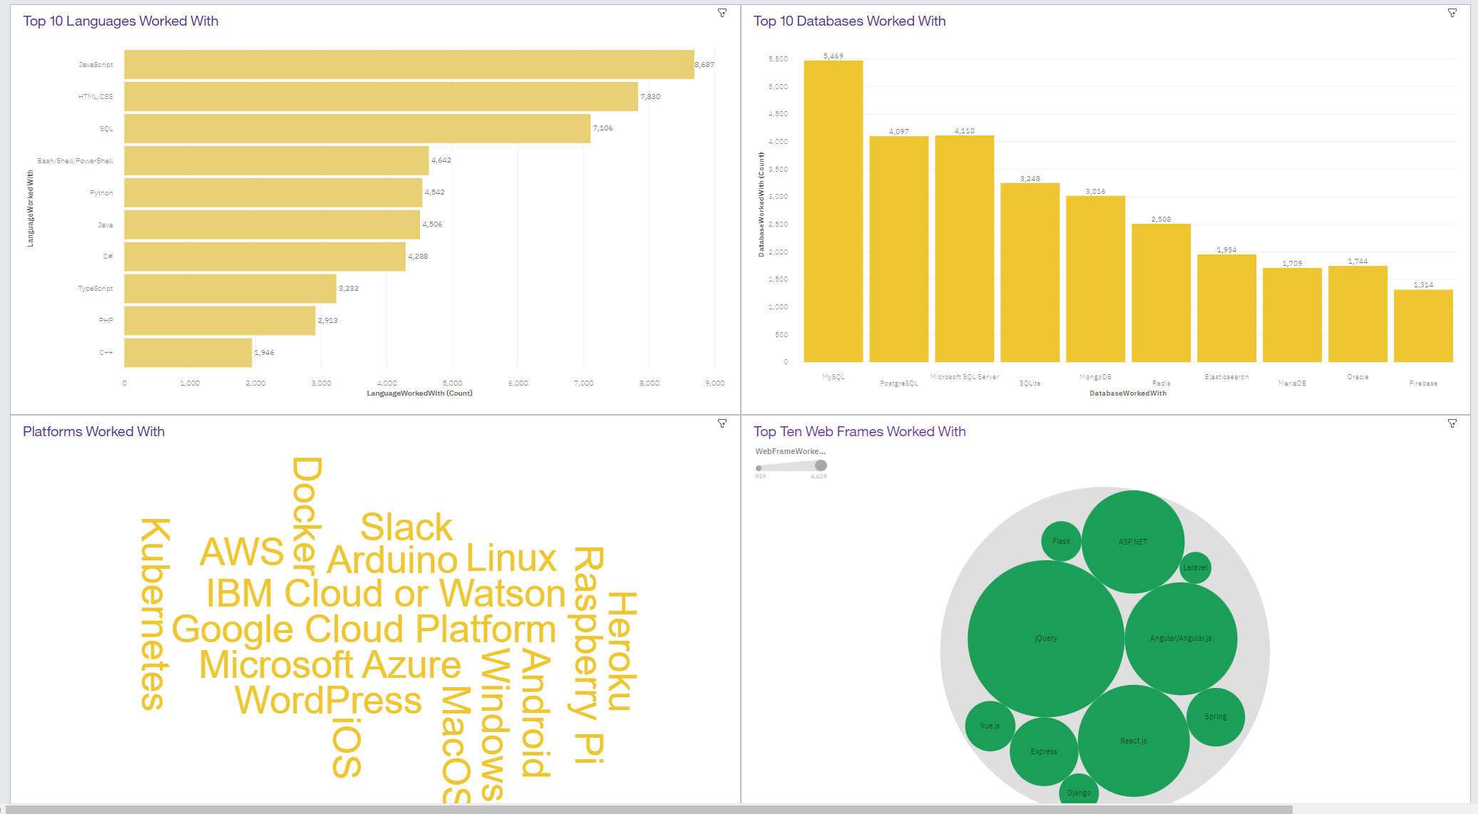
DASHBOARD TAB 1
Screenshot of dashboard tab 1 goes here

Slide 13
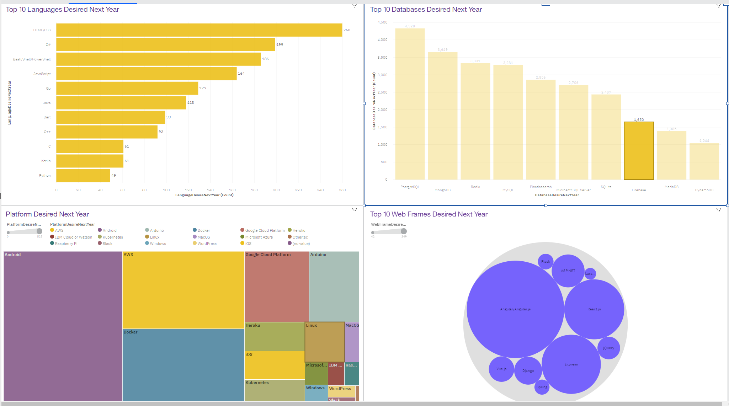
DASHBOARD TAB 2
Screenshot of dashboard tab 2 goes here

Slide 14
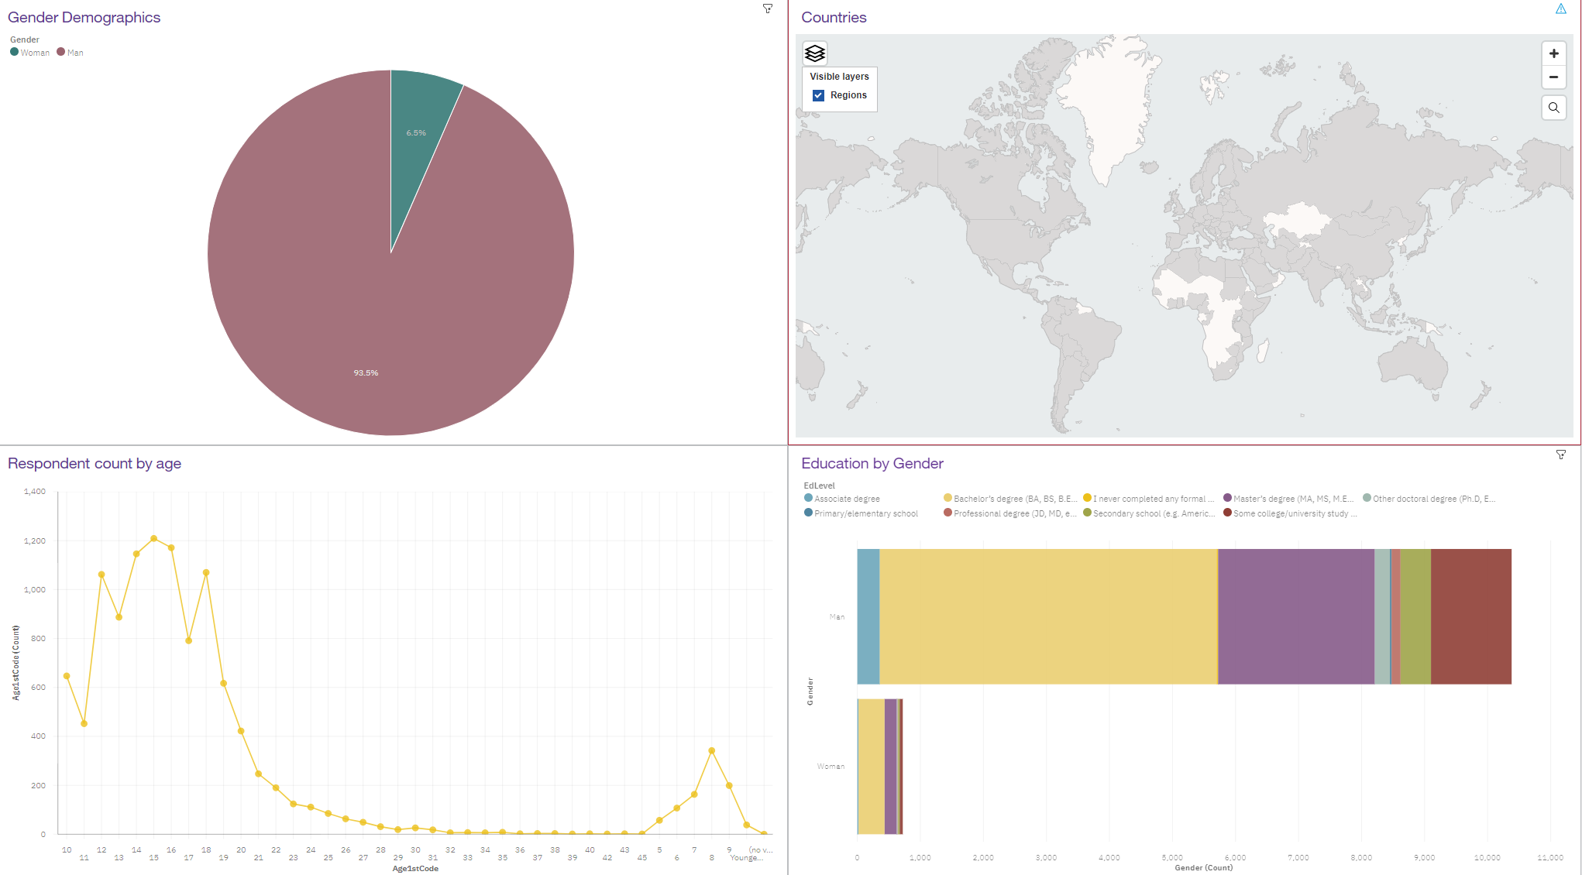
DASHBOARD TAB 3
Screenshot of dashboard tab 3 goes here

Slide 15
OVERALL FINDINGS & IMPLICATIONS
Findings
Tech Trends are constantly changing
The USA is the top tech country
There is a very large gender disparity
Implications
It is important to stay updated on trends
Other countries are slower to pick up on current data trends.
Gender discrimination may continue to grow over time.

Slide 16

CONCLUSION
Current Technology Usages Trends
Languages
Database
Platform
Web Frame
Future Technology Trends
Language
Database
Platform
Web Frame
Demographics

Slide 17
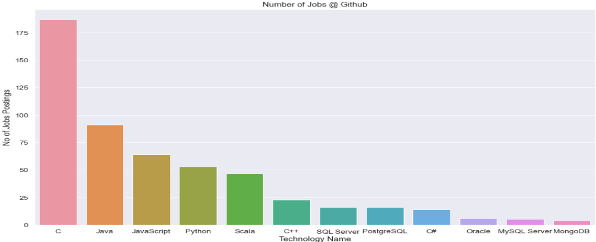
JOB POSTINGS

Slide 18
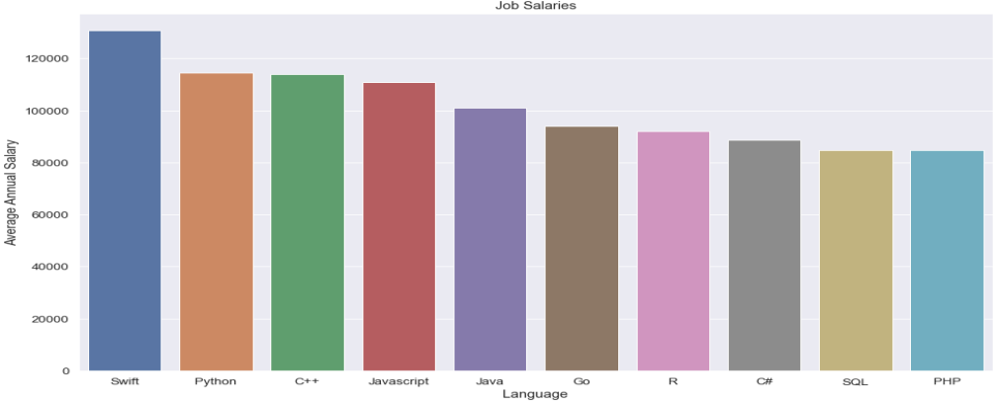
POPULAR LANGUAGES

